Slide 1
PXI Training
Notes:
In this PXI Express overview, we will briefly cover PXI and PXI Express fundamentals.

Slide 2
Agenda
PXI Fundamentals / Software
PXI Software
PXI Express
Main Support Issues
Quiz

Slide 3
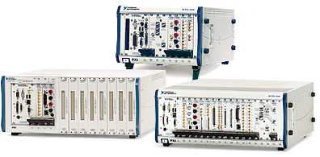
PXI Fundamentals
Notes:
Ayman Kabire
PXI GO-TO AE
Adam Ullrich
PXI –VXI PSE

Slide 4
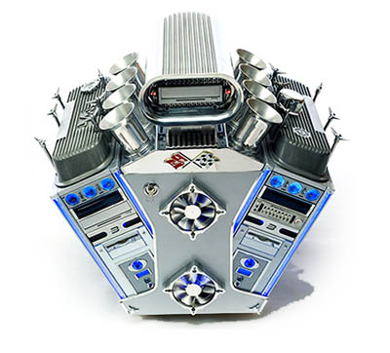
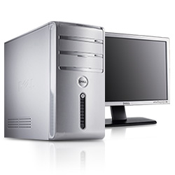


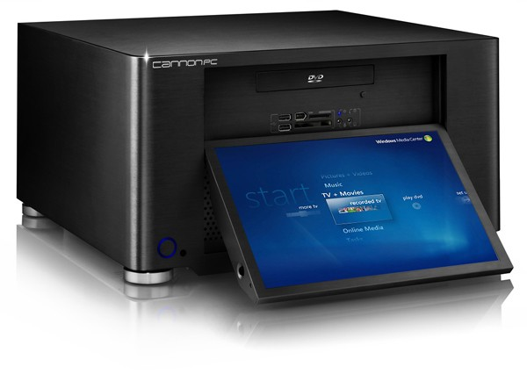
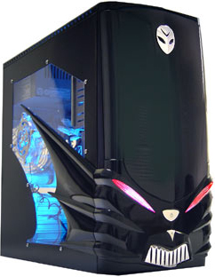
Computer Chassis
Notes:
When someone refers to a “computer” this could refer to a myriad of form factors. The end-use of the machine is going to be the biggest factor in deciding what your computer will look like.
You most commonly think of a Desktop PC, but there are also Mini-Laptops specialized for web-based applications. If you are concerned with looking the coolest you might be interested in the V8 Engine Computer. Servers are used specifically for hosting files, managing email, protecting a network, etc. A Home Theatre PC looks different because it is meant to be part of your living room. A gaming PC may have better graphics cards and network cards and some visual enhancements.
Even those these chassis may look very different and offer different peripheral bus options (USB, PCI, HDMI, CD-ROM, Ethernet, PXI, cPCI, etc.), they are all computers based on the same architecture. They are specialized for a certain functionality, but are fundamentally similar machines.

Slide 5
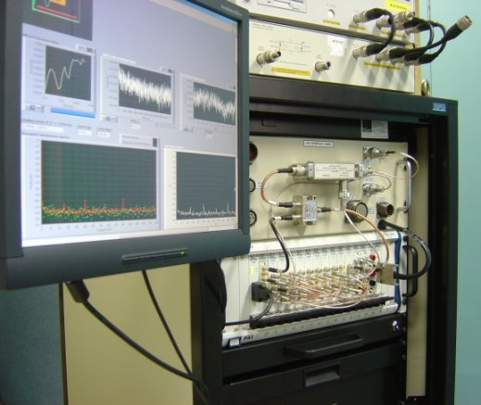
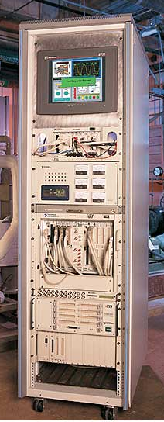
PXI
Notes:
PXI - Specialized for factor for high-performance, industrial applications.

Slide 6

Systems Alliance
PCI eXtensions for Instrumentation
Group of companies that provide PXI systems:
Promote PXI
Ensure Interoperability
Control the PXI Specification
Over 60 company members
www.pxisa.org
Notes:
PXI stands for PCI eXtensions for Instrumentation and does a good job of describing what PXI is, an instrumentation-specific extension of PCI Technology. The PXISA or PXI Systems Alliance is a multi-vendor group that governs the PXI Specification. The group promotes PXI, helps ensure interoperability and controls the specification. The first part of this training will focus on the first revision of the PXI specification or PXI-1. The PXISA is an excellent resource for any customers wanting to know more about creating PXI boards or the specification.

Slide 7
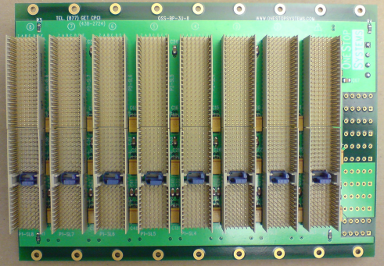
PCI  cPCI  PXI
1992 – PCI
Replaced VESA Local Bus in PC’s
Still widely in use
1995 – cPCI (CompactPCI)
Designed for PCI-based industrial computers
PCI protocol on a new physical form factor
1997 – PXI
Introduced by National Instruments
Uses same cPCI form-factor
Adds built-in timing and synch functionality
Notes:
PCI – highly successful bus protocol that has been around a long while and has spawned many variations and new protocols based on PCI such as PCIe, Mini PCI, CardBus, PCI-X, and CompactPCI
cPCI – Same high-speed PCI communication with a more rugged for factor designed for use in industrial environments. More rugged chassis, more robust connector, better-secured fit. NI does not sell cPCI cards or chassis, but cPCI cards should fit and work in a PXI chassis.
PXI – A superset of cPCI that adds PXI_trigger lines, a common 10 MHz timebase and other built-in timing and synch features. PXIsa standards ensure that any PXI card will fit into any PXI chasis.

Slide 8
Benefits of PXI
Moderate environmental tolerance (~0-50°C)
Thousands of available modules (NI + 3rd PXI+ cPCI)
Med to High-end processing
High performance PCI bus (110 MB/s real transfer rates)
Precise Timing and Synchronization (< 1ns)
Notes:
Some specific benefits of PXI relative to other product lines are
Moderate Environmental tolerance
Thousands of modules available since you can use NI modules, 3rd party PXI modules and compact PCI modules
Med-High end processing using the latest mobile computer technology
A high-performance PCI bus

Slide 9
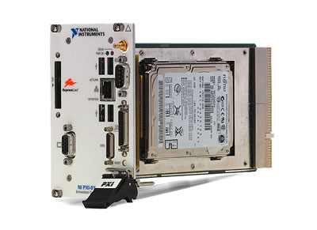
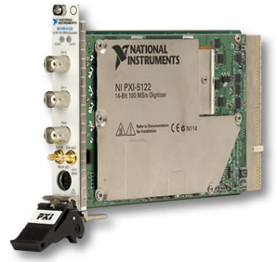
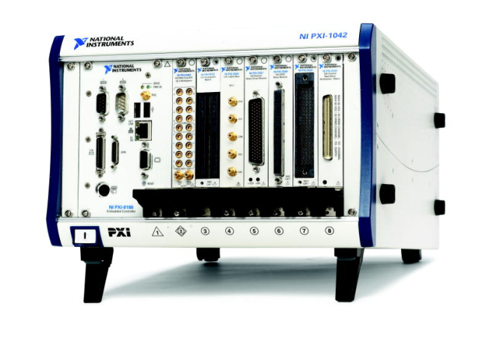
Components of a PXI System
Chassis
Controller
Modules
Notes:
These are the three main components of a PXI System: PXI Chassis, PXI controller (embedded or remote) and the PXI peripherals that are used in the system.

Slide 10
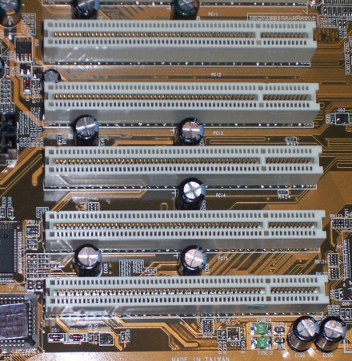
PCI Fundamentals
PCI provides two separate 32-bit or 64-bit address spaces corresponding to the memory and I/O port address spaces
A third address space, called the PCI Configuration Space
Firmware queries all PCI buses at startup
Four interrupt lines

Slide 11
Industry Bus Performance
10000
1000
Good
Better
Best
PCI/PXI (32/33)
Increasing (Improving) Bandwidth
Gigabit Ethernet
USB 2.0
100
Max Bandwidth (MB/s)
IEEE 1394a
VME/VXI
Fast Ethernet
10
GPIB (HS 488)
USB 1.1
GPIB (488.1)
1
10000
1000
100
10
1
0.1
Approximate Latency (μs)
Decreasing (Improving) Latency
Notes:
This graph shows various busses and their associated bandwidth and latency. Latency or the minimum time to do a single transaction is decreasing along the x axis and bandwidth is increasing along the y axis. To highlight popular industry busses, you can see where GPIB, USB 2.0 and the Ethernet families sit relative to each other.
PXI uses PCI communication which is the highest-bandwidth and lowest-latency bus on this chart, providing up to 132 MB/s.
In addition to bus throughput performance, PXI has timing and triggering lines for module synchronization…

Slide 12
PXI Timing and Triggering
Star Trigger Bus
10 MHz
CLK
System
Controller
System
Timing Slot
Peripheral
Peripheral
Peripheral
Peripheral
Local Bus
PXI Trigger Bus 0..7
Notes:
The additional Timing and triggering features of PXI allow modules to synchronize themselves in a variety of ways. The first feature is a 10 MHz system clock that is provided to each peripheral module. Modules can synchronize to this clock to achieve synchronization.
The second feature is the PXI Trigger bus (think of it as the RTSI bus from PCI). This parallel bus provides 8 trigger lines that can be used to send triggers or signals between devices. Because the bus is a parallel bus, skew can be introduced by bus load and trace-length mismatch. We do not recommend transmitting signals over 20MHz through the PXI trigger lines. To provide a method for limited-skew synchronization, PXI also incorporates..
A Star Trigger bus. This single-source, single destination bus can be sourced from the system timing slot and each trace is matched length to ensure minimal skew between devices.
The last synchronization bus is the Local Bus. This bus provides 13 to the left and 13 lines to the right peripheral module. These are isolated connections that can be used to transmit analog signals for SCXI Combo-chassis use and only connect adjacent modules. The local bus is not a widely used PXI feature.

Slide 13
PXI Slots Capabilities
In the PXI chassis, each slot has a glyph associated with it
Controller, Star and Module slots have different P1 and P2 pin-outs
Controller Slot
Star Trigger Slot
Module Slot
PCI Segment Divider
Notes:
This slide speaks for itself.
KB 2W1AOUWD : How do National Instruments PXI Boards map to the PXI Backplane?

Slide 14
PXI Chassis
Three Families of Chassis
Basic (Single Segment)
4 Slot
6 Slot
8 Slot
Multi-Segment
14 Slot
18 Slot
18 Slot 6u
PXI-SCXI Series
Notes:
First we’ll cover the chassis. There are 3 basic families of chassis. Basic or single-segment, Multi-segment and PXI-SCXI combo chassis

Slide 15
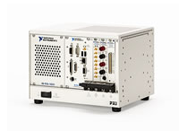
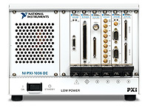
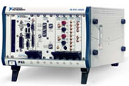
PXI Chassis: Single Segment
PXI - 1031
PXI - 1036
PXI - 1000B
PXI - 1042
PXI - 1042Q
Notes:
Here are each of the basic chassis. Those shown in grey are older chassis that NI purchased from other vendors. NI now designs most chassis in-house. The only older chassis still in use is the 1000B for DC power applications.

Slide 16
PXI Chassis: Single Segment
Chassis are ≤ 8 slots (single segment)
No need to route triggers
6-slot can only accept a 2-slot wide controller
1042’s can monitor power rails
Notes:
Basic chassis are < 8 slots. Longer backplanes require additional bridges for signal integrity.
Since there is only one segment, there is no need to route triggers across the PXI Trigger bus
The six-slot 1036 can only accept a 2 slot-wide controller.
The “better” chassis like the 1042 series switch LED monitors power has an input and output BNC for the 10MHz backplane clock and a DSUB for analog voltage monitoring and turning off chassis power remotely.

Slide 17
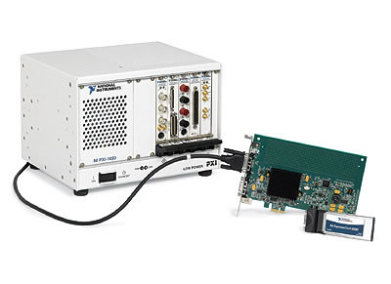
PXI Chassis: Single Segment
PXI-1033 5-slot
Built-In MXI controller
Notes:
No need for a PXI-MXI card. Built in port on the back of the chasis.

Slide 18
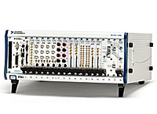
PXI Chassis: Multi-segment
PCI-PCI Bridge
PXI Trigger Bridges
PXI - 1044 14-slot
PXI - 1045 18-slot
Notes:
This is the multi-segment architecture
The 33 MHz PCI communication can only extend for about 8 slots before needing to be rebuffered. For our larger chassis, we use PCI-PCI bridges (a standard PC component) to extend the PCI through all slots in our larger (think 18-slot chassis)
To also improve the signal integrity for the internal triggering, we also rebuffer the parallel PXI Trigger bus using a PXI Trigger bridge. These triggers must be routed in software to drive signals across the segments. We’ll cover how you do this routing in the software section
As with the 1042, the 1044 and 1045 have power monitoring LEDs, Backplane 10MHz in and out BNC connectors and a DSUB connector for monitoring analog voltages and remote powering the chassis

Slide 19
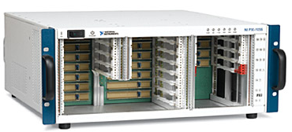
PXI Chassis: Multi-segment
Multi-Segment 6u
18-slot
Accepts a 3u controller
PXI-1056 18-slot 3u / 6u
Notes:
Most NI chassis support 3u modules. A ‘u’ is an amount of vertical space for modules. The PXI specification also allows for 6u modules to allow more vertical peripheral space. At the end of 2005, we began selling the 1056 chassis which will accept both 3u and 6u modules. There are brackets that allow you to configure your 1056 to accept up to 17 3u modules like the 1045 or 7 6u and 3 3u modules. Note that this chassis does not accept VXI modules!
The 1056 has similar PCI-PCI bridges and PXI trigger routers to the 1045 and 1044 chassis. An important note is that the DSUB on the 1056 does not provide analog voltages, it provides a serial interface to query voltage values.

Slide 20
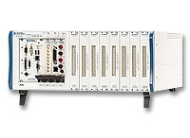
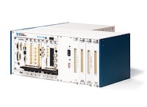
PXI Chassis
PXI-SCXI Series
PXI – 1011/1052
PXI – 1010/1050
Notes:
The PXI-SCXI combo chassis allow customers to use an integrated system to do signal conditioning and PXI. The left section is either 4 or 8 PXI slots. The rightmost slot can use the local bus lines to control the SCXI portion. If your module cannot use local bus, you can externally cable to the back of the 1010 or 1050 with an SCXI-1349 as you would with an external SCXI chassis. We’ll discuss some of the removal of Local Bus in the PXI Express section of the presentation.
KB 1NFF457T : Configuring a PXI-1010 or PXI-1011 Chassis

Slide 21
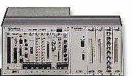
Support Alert!
Use a DAQ board to control the SCXI portion of PXI/SCXI Combo Chassis through the backplane
Must be in the last slot of the chassis!
Notes:
Use of the Local bus for SCXI combo chassis control is the typical use of this bus.

Slide 22
PXI Controller
Controller must be in leftmost slot (slot 1)
NI Embedded Controllers:
Controllers are PCs running an OS (Windows, RT, Linux, …)
Remote Controllers
MXI-3/4
MXI Express
Notes:
As mentioned previously, a PXI controller is essentially a computer where the chassis is the power supply and PCI bus. The controller must be in the left most slot (slot 1) of the PXI chassis. National Instruments only ships and supports PXI controllers running under Windows or RT OSes; however, users can install the Operating System of their choice.
NI makes a variety of embedded controllers built on different architectures. Some of these (like the 8140 series can only run RT)
We also make Remote controllers. Think of these as PCI extenders or bridges for MXI-3 and MXI-4 which allow you to connect PXI chassis to other chassis or a host computer. MXI Express is a PCI Express extender. Since these products use standard PC components, you don’t even need software to see boards behind them.

Slide 23
PXI Controller: Embedded
Fully functional computer
Controller in slot 1 of chassis
NI Embedded Controllers
Windows, Real Time OS, or Dual-Boot
PXI or PXIe
Notes:
PXI embedded controllers are built with laptop and PC components. They operate just like normal computers with a built in processor, memory, hard drive, and in older controllers, a floppy drive. They can have a monitor, keyboard, mouse, USB port(s), serial port(s), parallel port, etc.
Many embedded controllers can run windows or RT (or be dual-boot) and since the 8184, you no longer have to create an RT floppy boot disk. We now build the RT safe-mode into the BIOS where you can select which OS to boot.

Slide 24
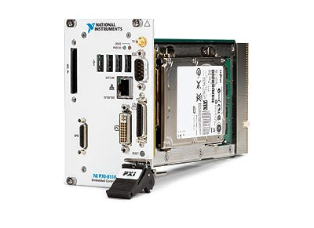
PXI Controller: Embedded
Latest and Greatest
PXI-8110
2.26 GHz, Quad Core
PXIe-8108
2.53 GHz, Dual Core
PXIe-8130
2.3 GHz, Dual Core, 64-bit
PXI-8101
1.6 GHz, 2-Slot
Notes:
This is a slide that shows the latest controllers.
8110 - http://sine.ni.com/nips/cds/view/p/lang/en/nid/206809
8108 – Not even out yet! Soon to be released.
8130 - http://sine.ni.com/nips/cds/view/p/lang/en/nid/203929
8101 – Not even out yet! Soon to be released.

Slide 25
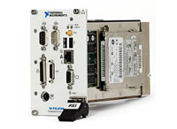
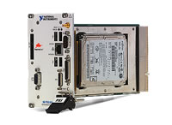
PXI Controller: Embedded
PXI - 8186
PXI - 8196
Video, Serial, Ethernet, Parallel , PS2, USB, GPIB and ExpressCard
Notes:
As we move to newer architectures, we may slightly change the peripheral I/O on our controllers such as the new DVI-I video connector on the PXI-8105. You’ll notice that the 8186 only has one PS2 port. We provide a single ps2 to dual ps2 dongles to get the KB and mouse port. The PXI-8196 controller provides a state-of-the-art ExpressCard slot and Gigabit Ethernet but does not provide the older PS2 keyboard and mouse ports. For customers that require these ports, we provide USB to PS2 dongles similar to the single ps2 to dual ps2 dongles
To briefly mention ExpressCard, ExpressCard provides a x1 PCI Express interface for up to 250 MB/s or USB 2.0 interface to a plug-in module. Though it looks like CardBus or PCMCIA, it is not.

Slide 26
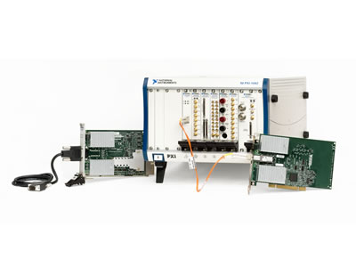
PXI Controller: Remote
MXI-3 (older)
84MB/s Bandwidth
Option of Fiber or Cooper Cabling
Allows control of PXI chassis from your PC
MXI-3 Optimization Software (Optional Bug Fix)
Install PXI-MXI module in controller slot
Boot PXI Chassis before PC
Notes:
MXI-3 is an older link that brings links PCI to give PCs direct control of PXI systems, or to link PXI chassis together. MXI-3 is a high-performance link that is transparent to software applications and drivers. It builds on the standard PCI-to-PCI bridge, and is recognized as one by operating systems.
Depending on your application, you can use copper cable board (PCI-8330 and PXI-8330) or fiber optic boards (PCI-8335 and PXI-8335). Copper cable MXI-3 links are useful for short distances (up to 10 meters). Fiber optic MXI-3 links are recommended when electrical isolation, EMI resistance or longer distances (up to 200 meters) are required. Use MXI-3 when you require the highest performance desktop processors on the market or when you want to reuse a computer you already have.

Slide 27
PXI Controller: Remote
MXI-4
78 MB/s sustained (Error Correction)
Fiber provides electrical isolation
Up to 200m per link (OTS) or ~300m with custom cabling
MXI Express PCIe to PXI (PCI)
110 MB/s from the host to 1 chassis, 160 MB/s for 2 chassis (8362)
Independent PCIe lanes on the host allow multiple 110 MB/s pipes to multiple chassis
7m distance limit
Not for PXI-PXI
Notes:
MXI-4 was released after MXI-3 however its sustained throughput is less than MXI-3 because of the added error correction. Fiber optic or copper wiring is available. Fiber optic cables provide electrical isolation and can be extended for longer distances (200m off the shelf or 300m with customer cabling).
MXI-express is an interface from PXI Express to PCI (PXI). IT has a throughput of 110MB/s when communicating between the host and a single chassis. It has a total of 160 MB/s when communicating with 2 chassis ( 80MB/s per chassis) when using a 2 port MXI interface (PCI-8362). And since it’s PCIe, this can be dedicated bandwidth to the host. There is however, a 7m distance limit and since the root is PCIe, it can’t be used to go from a PXI slot to another PXI chassis.

Slide 28
PXI Controller: Remote Laptop
PXI-CardBus 8310
CardBus to PXI kit OEM’d from Magma
Not recommended if ExpressCard is an option
50 MB/s to host, 10 MB/s from host
List of tested laptops online
MXI Express (ExpressCard MXI)
Same throughput as MXI-Express
Laptop host traditionally slower than desktop
List of tested laptops online
Notes:
These are the remote controllers that are used to control PXI chassis from laptops. The first one is the CardBus-8310 which has a throughput of 50MB/s to host and 10MB/s from host. There is a list of compatible laptops in our website. Here is the link (http://zone.ni.com/devzone/conceptd.nsf/webmain/40C6006F85B25FA18625702E00578407). Keep in mind that the 8310 does require an additional driver to operate at all.
MXI-ExpressCard was released in 2005 and hence the CardBus is not recommended if customers have the ExpressCard slot in their laptops. The reason is because with MXI-ExpressCard, we can sustain throughput rates similar to the ones we can sustain with MXI-Exprss (110 MB/s). Again, there is also a laptop compatibility list in our website (http://zone.ni.com/devzone/conceptd.nsf/webmain/23F563A4255EB50F8625702D005A9D07)

Slide 29
PXI Controller: Remote
Connecting Multiple PXI Chassis Using MXI
Notes:
This image only shows computer to PXI chassis, but keep in mind that a PXI chassis with an embedded controller can connect to another PXI chassis through MXI-3/4.
MXI-3/4 and Express will show up in the Device Manager as a PCI-PCI bridge. You won’t see it under devices and interfaces but it will show up under your PXI system after you’ve installed your PXI Software.

Slide 30
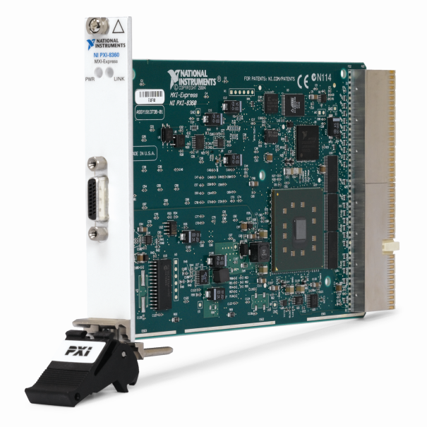
PCI Control of PXI
Laptop – CardBus MXI
PCI
PXI
Desktop – MXI3/4
PCI
Notes:
For remote control of PXI, MXI-Express was released to provide the fastest PXI Remote controller achieving 110 MB/s sustained throughput from PXI to the host.

Slide 31
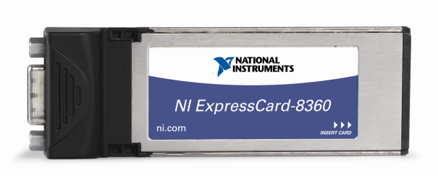
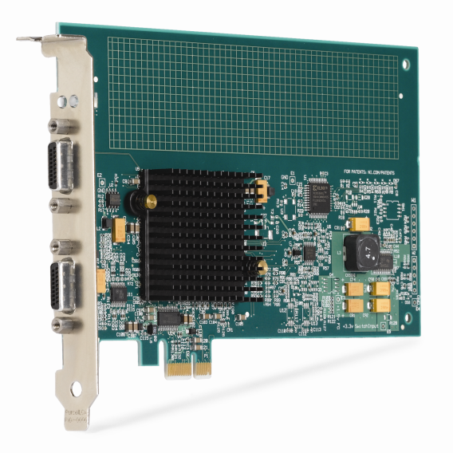
PCI Express Control of PXI
Laptop – ExpressCard MXI
PCI Express (x1)
PXI
Desktop – MXI-Express
PCI Express (x1)
110 Mbytes/s sustainable throughput
Notes:
For remote control of PXI, MXI-Express was released to provide the fastest PXI Remote controller achieving 110 MB/s sustained throughput from PXI to the host.

Slide 32
PCI Express Control of PXI Express
Laptop – ExpressCard MXI
PCI Express (x1)
PXI Express
Desktop – MXI-Express
PCI Express (x1)
>200 Mbytes/s sustainable throughput*
*Initial Results
Notes:
Using the same host board and cable, the PXIe-8360 achieves throughput to the host of over 200 MB/s sustained. In fact, if you have the two-port version of the PCIe MXI-Express host board, you can connect any combination of PXI and PXI express chassis to your host computer.

Slide 33
Ethernet Remote Control – Ethernet
Communicate with the PXI host over Ethernet
Remote Desktop
Custom program communicating over TCP/IP
Allows for additional distance, flexibility
Wireless networking
Isolation
Very long-distance

Slide 34
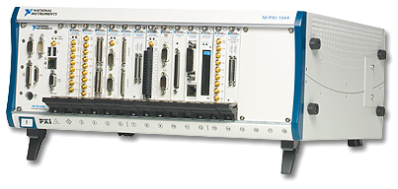

Using Multiple controllers
Ethernet
HUB

Slide 35
PXI Software

Slide 36
PXI Software
Allows you to identify your PXI system
Installed with DAQmx & VISA
CHASSIS.INI & CONTROLLER.INI
C:\Program Files\National Instruments\PXI\Hardware Descriptions
PXISYS.INI
C:\Windows\System
Identify a module’s slot
PCI Bus Number, Device Number
Hardware-Specific (Combination of Chassis & Controller)
Trigger Routing (DIM for DAQmx)
Notes:
PXI software is what allows you to identify your PXI chassis and show our driver software that it isn’t just a PC.
After identifying your controller and chassis through MAX, it will use the associated controller and chassis.ini files to create a pxisys.ini file that describes your system. This description of your hardware architecture along with the PCI bus number and device number allows us to identify what slot your module is in.
Without this information, we couldn’t automatically route and reserve PXI_Trigger lines which a lot of people assume just happens.
KB 1EGB71UI : What Are PXISYS.INI and CHASSIS.INI?
At boot up by BIOS

Slide 37
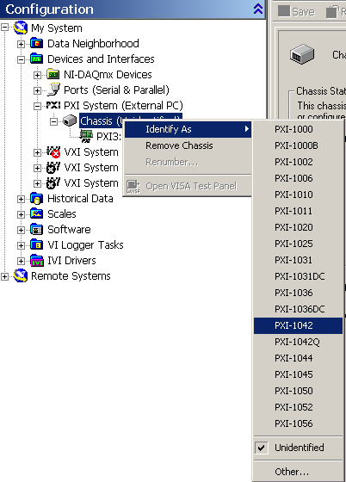
PXI Software: Identification
Outlined in the user manual
Other components know where a device is
Notes:
PXI-1 system identification is relatively easy. All you have to do is open MAX, right click on your PXI system and identify it.
This allows other components to know where a device is so that you can do things like automatically route across segments and know that a PXI board is in the last slot of a combo chassis so it can control the SCXI side.

Slide 38
Route and Reserve Triggers
You can route and reserve through MAX (static)
You can route and reserve through VISA
The driver can route and reserve for you (DAQmx)
Supported in Linux
Notes:
Using PXI Timing and Triggering Functionality
http://digital.ni.com/public.nsf/websearch/BD37A128B1DF27F3862570FC0072359D?OpenDocument

Slide 39
PXI & Linux
Moving PXIrm from Windows to Linux
Differences:
No MAX
Command-line configuration
Scriptable (not available under Windows)
Similarity:
PXIrm is still shipped with VISA and DAQmx (no standalone installer)
Notes:
Configuring Your PXI System in Linux
http://digital.ni.com/public.nsf/websearch/0D17FF318206CFE6862570DF000C0151?OpenDocument

Slide 40
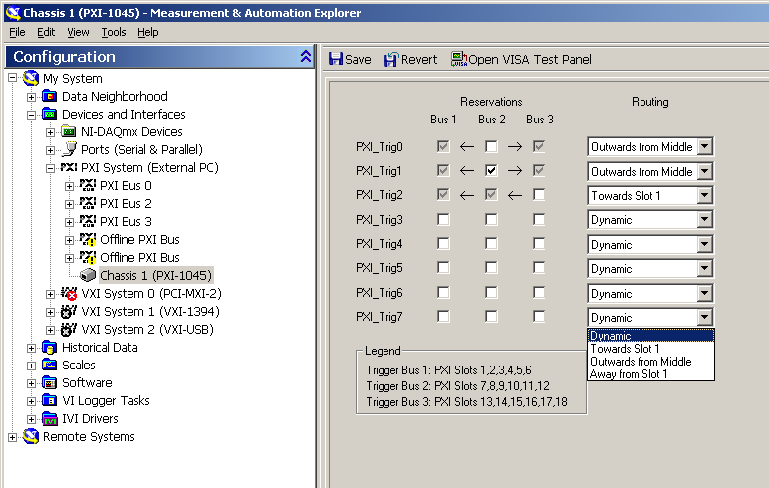
PXI Software: MAX
Notes:
You can statically route triggers through MAX. Make sure to save your changes

Slide 41
Exercise 1
Multi-chassis system setup
Objective: Become familiar with the software and hardware used to control PXI systems and identifying a system through software.
Notes:
Required equipment:
2 PXI MXI-3 or MXI-4
2 PXI Chassis (1 of which is a SCXI combo)
1 Embedded controller
Two PXI boards (one DAQ that can control SCXI)
One or two SCXI modules to detect
Set up a system with an embedded controller daisy-chained to another chassis and ensure that you can detect the two PXI boards. You will then set up the SCXI devices in MAX and ensure you can autodetect them properly.

Slide 42
PXI Express Technology
Notes:
In this section, we will discuss the addition of PCI Express technology to PXI Express and the additional bandwidth, timing and triggering features PXI Express adds to the PXI Platform.

Slide 43
PCI Express Technology
Transparent to the User
Changes the abstracted layers of PCI
Convert PCIe to PCI through bridges
Serial Interface
250 MB/s in each direction per lane
Multiple widths “x1”,“x16”
250 MB/s to 4 GB/s each direction
Dedicated bandwidth
Notes:
PCI Express technology provides improvements over PCI technology without sacrificing compatibility. PCI Express changes the physical interconnect to an independent serial interface. Since the lower levels are abstracted away from software interaction, PCI Express is completely compatible with software designed for PCI hardware. In fact, you can easily convert between PCI Express and PCI by using a PCIe to PCI bridge.
The PCI Express interface is described in terms of “width” of the serial interface. The width is described in terms of lanes or 250 MB/s pipes in each direction. To calculate the bandwidth supplied by each link, simply multiply the link width by the bandwidth of a single lane. A “by-one” link provides 250 MB/s to and from the PCI Express peripheral. A x4 provides 1GB/s in each direction and a x16 can provide up to 4GB/s in each direction! Also, because the interface is independent serial instead of a shared parallel bus like PCI, each link provides dedicated bandwidth.

Slide 44
PXI Express Bandwidth
NI PXIe-1082 Express Chassis
NI PXIe-8133 Express Controller
2 GB/s of lane bandwidth
PCIe Switch
PCIe Switch
PCIe Switch
Controller Slot
Express Slot
Express Slot
Timing Slot
Hybrid Slot
Hybrid Slot
Hybrid Slot
Hybrid Slot
1
2
3
4
5
H
6
H
7
H
8
H

Slide 45
Leveraging PCI Express
PCI Express
250 MB/s to 4 GB/s
Independent Serial Bus
PXI Express
Modules up to 2 GB/s
Host up to 6 GB/s
PCI
132 MB/s
Shared Parallel Bus
PXI
132 MB/s Shared
Notes:
The bandwidth gains of PCI Express have been leveraged in the PXI Express specification
The PXI Express Specification increases module bandwidth from the shared 132MB/s of PXI up to 2GB/s and host bandwidth up to 6GB/s

Slide 46
Additional Features in PXIe
Supplied Power and Cooling Increase
Geographical Addressing
Timing and Synchronization
100 MHz differential clock
Differential Star Triggers
Notes:
In addition to improving controller and module bandwidth, The PXI Express Specification adds other features such as…
Increasing available power to modules to 140 W for the system controller and 30 W for a peripheral module to allow for modules with higher power requirements.
Geographical addressing allows hardware or software to read the slot position of a PXI Express module using backplane pins
Additional timing and triggering signals improve upon the first revision of PXI (PXI-1).

Slide 47
PXI
100 MHz
Differential CLK
PXI Express
Star
Trigger
10 MHz
CLK
PXI Express
System
Controller
PXI Express
System
Timing Slot
PXI Express
Hybrid
Peripheral
PXI Express
Hybrid
Peripheral
PXI Express
Hybrid
Peripheral
PXI
Peripheral
PXI Trigger Bus (8 TTL Triggers)
Notes:
PXI Express adds additional signals to the PXI-1 specification discussed in the first section. The diagram above is a PXI Express extension of the PXI diagram used in the “what is PXI” section. Note that all slots are PXI Express capable but the rightmost slot. All PXI-1 timing and triggering features but local bus are still distributed to every peripheral slot.
In this diagram, we’ll show PXI Express additions to PXI-1 timing and triggering features in orange.
The first addition is a 100MHz differential clock. As with other PXI Express timing and triggering features, the clock is only routed to PXI Express slots.

Slide 48
Comparing PXIe_CLK100 and PXI_CLK10
PXI_CLK10 preserves compatibility with PXI modules
PXI_CLK10 is synchronous to PXIe_CLK100
Specifications comparison:
 | PXIe_CLK100 | PXI_CLK10
Frequency | 100 MHz | 10 MHz
Logic Family | LVPECL, Diff | TTL, SE
Freq. Accuracy | ±100 ppm or better | ±100 ppm or better
Skew | ≤ 200 ps | ≤ 1 ns
Notes:
Two important details to note are that PXI_Clk10 is synchronous to PXIe_CLK100 so devices that use either PXI_CLK10 or PXIe_CLK100 as a reference clock are synchronized
Additionally, the skew of the new clock has been improved from a module-to-module skew of <= 1ns to < or = 200ps to minimize skew between peripheral devices.

Slide 49
PXI
100 MHz
Differential CLK
PXI Express
Star
Trigger
SYNC100
10 MHz
CLK
PXI Express
System
Controller
PXI Express
System
Timing Slot
PXI Express
Hybrid
Peripheral
PXI Express
Hybrid
Peripheral
PXI Express
Hybrid
Peripheral
PXI-1
Peripheral
SYNC Control
PXI Trigger Bus (8 TTL Triggers)
Notes:
Another addition in PXIe is the Sync100 signal…

Slide 50
PXIe_SYNC100
Differential LVPECL signal
Delivered to each PXIe peripheral slot
10ns pulse coordinated to PXI_CLK10
Notes:
The Sync100 signal is a differential signal delivered to each PXIe peripheral slot. Sync100 provides a 10ns pulse that is coordinated with the rising edge of PXI_CLK10. As you can see from the timing diagram, a 10ns pulse on Sync100 precedes a rising edge of PXI_CLK10.

Slide 51
PXI
100 MHz
Differential CLK
PXI Express
Star
Trigger
SYNC100
10 MHz
CLK
PXI Express
System
Controller
PXI Express
System
Timing Slot
PXI Express
Hybrid
Peripheral
PXI Express
Hybrid
Peripheral
PXI Express
Hybrid
Peripheral
PXI-1
Peripheral
SYNC Control
Differential Star
Triggers
PXI Trigger Bus (8 TTL Triggers)
Notes:
To minimize skew between peripheral devices, the PXI-1 specification provides a point-to-point Star trigger for matched trace-length signaling from the system timing slot. PXI Express adds three Differential Star triggers to the specification to allow for higher frequency signaling with less jitter.

Slide 52
Differential Star Triggers
PXIe_DSTARA, PXIe_DSTARB, PXIe_DSTARC
Matched length to minimize skew
Differential, point-to-point connections
Connect PXIe peripheral slots and System Timing slot
Notes:
The three PXI Express star triggers are named DSTAR a, b and c. These are matched-length differential point-to-point connections between the system timing module and PXI Express peripheral modules

Slide 53
PXI Express Implementation
Notes:
This section focuses on the implementation of the architectures for PXI Express technology that we just discussed

Slide 54
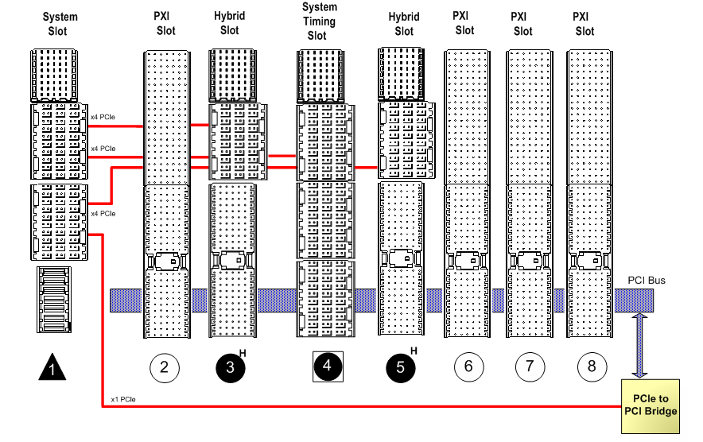
PXI Express Chassis
Notes:
Here we have a diagram of a PXI Express Chassis. There are four new slots making a total of 5 slot types in the PXI Express standard…
As we discuss each slot, you will notice leveraged connectors that provide …
PXI-1 Timing and Triggering functionality, PCI communication, and PCI Express communication and triggering

Slide 55
PXI Express System Controller Slot
Notes:
The First slot type is the PXI Express System Slot. This is the slot for your PXI Express Embedded or Remote controller and provides PCI Express connections to the chassis backplane. This diagram shows a system controller slot in a four-link chassis

Slide 56

PXI Express System Controller Slot
Accepts a PXI Express controller
PCI Express Signaling
Four-link: four x4
Two-link: one x8, one x16
PXI_Trig0..PXI_Trig7 connectivity
Notes:
The PXI Express System Controller slot can only accept a PXI Express controller
The PXI Express specification allows for two different link modes. The first is a four-link architecture that provides four PCI Express links of up to x4 width for a maximum bandwidth of 4GB/s to the host. The two-link mode provides one x8 link and one x16 link for a maximum of 6GB/s. The PXI Express chassis determines which link mode is used
The controller slot also provides access to the parallel PXI Trigger bus

Slide 57
PXI Slots
Notes:
The second slot type is the PXI peripheral slot.

Slide 58

PXI Peripheral Slot
Defined in the PXI-1 specification
Provides 32-bit / 33MHz PCI signaling
Provides All PXI-1 timing and triggering
Point-to-point Star Trigger
PXI Trigger bus
Local Bus
10 MHz system clock PXI_CLK10
Notes:
PXI slots were defined in the PXI-1 specification and are used by PXI modules, chassis and controllers. They provide PCI signaling and PXI timing and triggering features. These features which we covered in the “what is PXI” section are the point-to-point star trigger, the parallel PXI trigger bus, the local bus and the 10 MHz system clock PXI_CLK10.
The PXI Express specification leverages these slots for existing PXI peripheral modules

Slide 59
PXI Express System Timing Slot
Notes:
The third slot type is the PXI Express system timing slot. This slot provides the necessary connections to drive both the new timing and triggering features of PXI Express and the incorporated features of the PXI-1 specification

Slide 60

PXI Express System Timing Slot
PCI Express Signaling
PXI-1 and PXI Express Timing and Triggering
System Timing Module or PXIe Peripheral
Optional
Notes:
The system timing slot uses PCI Express signaling and provides the necessary connections to drive and accept both PXI and PXI Express Timing and Triggering signals. The System Timing Slot can also accept a PXI Express peripheral. This slot is optional for PXI Express chassis.

Slide 61

PXI Express Peripheral Slot
PCI Express Signaling
PXI-1 and PXI Express Timing and Triggering
Accept a PXI Express module
Notes:
The fourth slot type is the PXI Express Peripheral slot. These slots provide PCI Express signaling and access to most PXI-1 and all PXI Express timing and triggering signals.

Slide 62
Hybrid Slots
Notes:
The fifth and final slot type is the PXI Express Hybrid Slot.

Slide 63

PXI Express Hybrid Slot
PCI and PCI Express Signaling
PXI Express or Hybrid-Compatible PXI
Notes:
The Hybrid Slot combines the PXI Express Peripheral and most functionality from the PXI-1 Peripheral slot. This allows you the flexibility to put a PXI Express Peripheral or a Hybrid slot-Compatible PXI peripheral into the slot depending on your system needs. Taking a look at the connectors, we can see how this slot can accept either module.

Slide 64

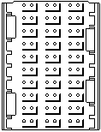

PXI Express Hybrid Slots
Power
Trigger Bus
Star Trigger
Clk. 10
x8 PCIe
(up to 2 GB/s)
Differential
Clk. 100 &
Star Triggers
Reserved Pins
Local Bus
(typically unused)
32/33 PCI
(132 MB/s
per system)
PXI Express Hybrid
PXI
Notes:
The J1 connector from the PXI slot remains intact. This provides the PCI signaling to a PXI peripheral module. The top connector known as XJ4, provides power, the PXI Trigger bus, the PXI Star Trigger and Clk 10 functionality.
In PXI slots, the bottom of the J2 connector contained some reserved pins and support for Local Bus triggering. Local Bus triggering was not widely adopted and is unavailable in PXI Express Hybrid slots. If a PXI Express chassis provides PXI slots, they retain Local Bus for modules that require it.
The new PXI Express Hybrid slot replaces this portion of the connector with a PXI Express connector that provides up to x8 PCI Express signaling for up to 1GB/s bandwidth in each direction. In addition, the connector provides PXI Express timing and triggering signals.
So what about NI and Hybrid-Compatible modules? Keep in mind that no local bus means no SCXI control through the PXI/SCXI chassis backplane

Slide 65
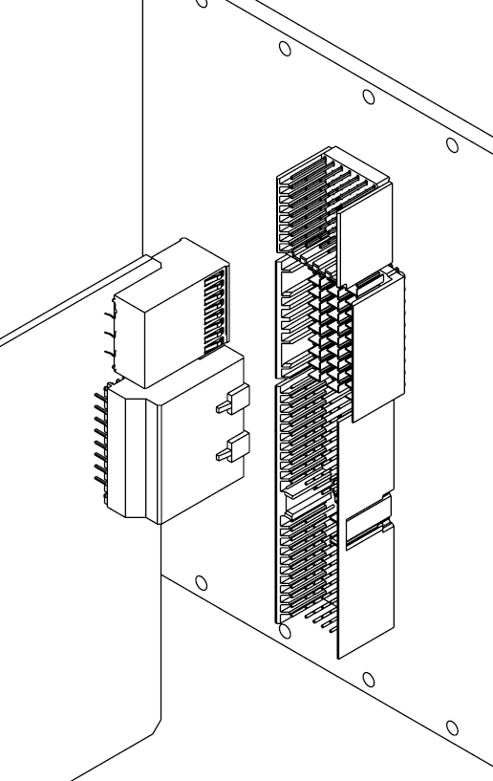
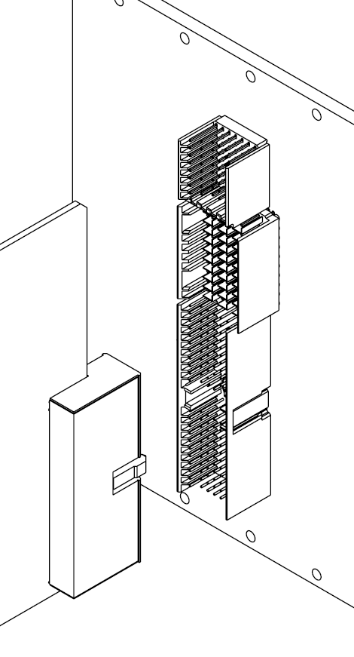
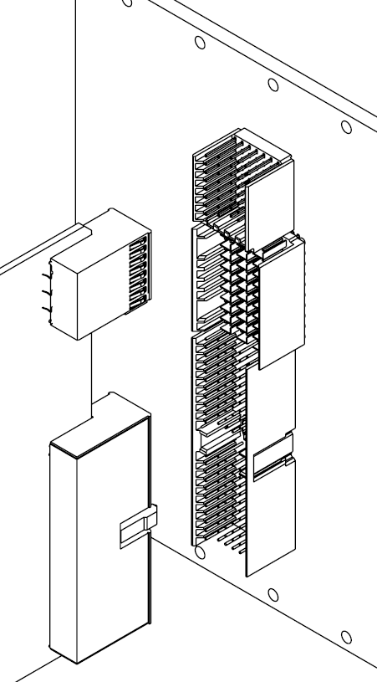
Hybrid Slot-Compatible Modules
PXI Express
Peripheral Module
32-bit CompactPCI
Module
Hybrid Slot-Compatible PXI Module
Notes:
This slide shows how different boards are used with a PXI Express Hybrid Slot. At the left you can see that a PXI Express Peripheral uses the top two connectors. In the center, a Compact PCI module uses the PCI portion of the hybrid slot. On the right, a Hybrid Slot Compatible PXI module uses the top connector for timing and triggering and the bottom connector for PCI communication.

Slide 66


Peripheral Slot Summary
Timing
Hybrid
PXIe
PXI
PXI Timing/Triggering
PCIe PXIe Timing/Trig
Local Bus
PXIe System Timing
PCI
Notes:
To summarize the features of each peripheral slot,
PXI timing and triggering features area available to all PXI Express peripheral slots
PXI Local Bus is available in PXI slots
PCI signaling is available in both Hybrid slots and PXI slots for PXI or Compact PCI modules
PCI Express signaling and PXI Express timing and triggering signals are available to the System Timing, PXI Express and Hybrid slots
Only the PXI Express System Timing Slot can drive PXI Express timing signals

Slide 67
Support Issues

Slide 68
Support Issues
BIOS Features
Common PXI Issues
Real-time on PXI Controllers
Touch Panels

Slide 69
The BIOS of your PXI Controller…
Every computer has a BIOS (Basic Input Output System)
BIOS serves as an interface between computer’s hardware and operating system (Windows, etc.)
Computers boot from the BIOS before the operating system
To enter/alter the BIOS settings, press <DEL> key as computer comes on
Note: The BIOS is stored in a different location from the computer’s CMOS, which contains the system set-up parameters (although you can modify these through the BIOS)

Slide 70
What typically happens when your computer first boots?
Reads a 16-bit address that sends you to the location of the BIOS on the computer, begins the boot process
POST (Power On Self Test) – Initializes and tests individual hardware components (Hard drive, video card, network card, etc.)
Look for and load the operating system

Slide 71
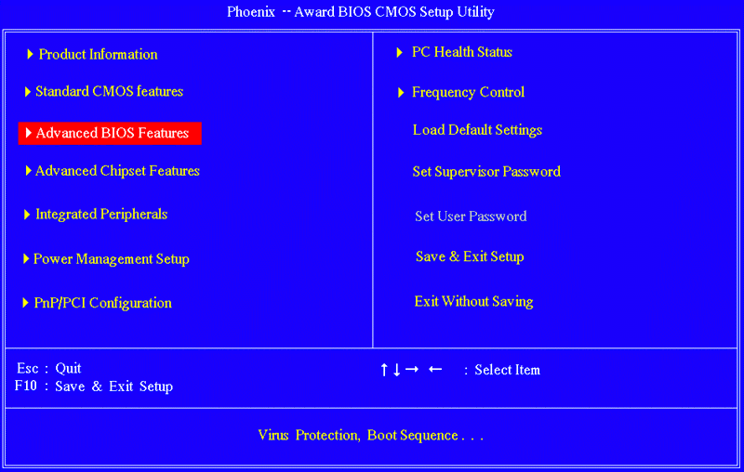
BIOS Options
Notes:
Advanced BIOS Features – Virus Protection, Boot Sequence (Where will you search for your OS first?)

Slide 72
PXI Issues: Chassis
Red Light flashes on power button
KB!
Notes:
AE KB 33DARAON: System Power Indicator LED on PXI Chassis [Internal Only]
http://ae.natinst.com/operations/ae/public.nsf/web/searchinternal/5398655a1de9947e86256dde00626437?OpenDocument

Slide 73
PXI Embedded Controller Issues..
Hard Drive Failure
Run the PXI/PXIe Hard drive diagnostic (HDD)
USB drive for HDD needs to be created on Windows machine
HDD can be run on any hard drive, regardless of OS
If the HDD fails, they need a new hard drive (RMA)
If the HDD passes, they should try restoring their operating system..

Slide 74
PXI Embedded Controller Issues..
Need to Restore Operating System
Options:
Phoenix Firstware or Acronis Recovery Utilities (Press F4 or Alt during boot)
Restore OS to Factory Default
OS Recovery CD/Floppy
Change BIOS to boot from CD-ROM (even for USB CD-ROM drive) or Floppy Drive as appropriate
Additional peripheral drivers are located at: C:\Images\Directory
Boot from USB
Make sure USB drive has been configured to be bootable
Change BIOS to boot from USB drive

Slide 75
PXI Embedded Controller Issues..
Need to Restore Operating System (Cont.)
Options:
Boot from Images Directory
Boot PC from floppy drive or USB key into DOS
In the command prompt type “deltree C:\*.*” NOTE: Do not delete images directory
Reinstall XP by Winnt in C:\images\os\I386
Once reboot choose option to set up Windows.
Boot from Network
Boot PC from floppy drive or USB key into DOS
Access Network and install appropriate OS

Slide 76
PXI-MXI Issues..
1. Error Code 12 or Computer freezes at BIOS screen with MXI-Express
Error 12: “Device could not find enough free resources that it could use..”
Computer’s BIOS does not comply with PCI standard to include support for many PCI resources
National Instruments is working to test computers, check knowledgebase article for what computers have been tested: 3U7CI4D8

Slide 77
PXI-MXI Issues..
2. Error Code 10:
Error 10: “This device cannot start ” next to PXI device in Device Manager
First make sure they have the most recent, appropriate device driver
If they have an HP computer from knowledgebase article: 43DEOSX5:
Upgrade computer to latest BIOS
Download Core Driver Update (in KB)

Slide 78
PXI-MXI Issues..
3. Dell Computer does not boot with MXI-PXI system connected
Could be “Not enough Resources” problem..
Removing, Rearranging boards sometimes helps
National Instruments is working with Dell to determine the source of the problem

Slide 79
PXI-MXI Issues..
4. Computer freezes at Windows boot with ExpressCard-8360 + PXI 1033 chassis
Mostly seen with Dell Laptops
Try hot-plugging the ExpressCard-8360 into the laptop
R&D is redesigning the ExpressCard-8360 to better handle power management

Slide 80

Real Time and PxP
PXI controllers can be Windows, RT or dual-boot
RT OS issues are supported by Distributed Controls (DisCo)
PXI Controller hardware issues (if independent of RT OS) are supported by PxP

Slide 81

What is Real Time?
Real-time means determinism
Determinism is the ability to complete a task within a fixed amount of time
Real time does not always mean real fast
Real-time systems have timing constraints that must be met to avoid failure
Notes:
To begin, let’s define the term real-time in the context of this seminar. Real-time does not necessarily mean real fast. This is the most common misconception about Real-Time. Some real-time systems are indeed fast, but it isn’t always a one to one correlation. Real-time systems are designed to be more reliable than standard software systems. Real-time systems are those that have timing constraints that must be met to avoid failure. For example, the airbag system in your car requires a real-time system to be able to deploy within a fixed amount of time. If it fails to deploy in time, a driver or passenger could be seriously hurt. An airbag system is deterministic and predictable, meaning it will deploy within a fixed amount of time.

Slide 82
Determinism = Bounded Jitter
Jitter Range
Desired Loop Time
Maximum
Jitter
1
2
Loop Iteration
3
4
5
Loop Time (seconds)
Notes:
Another way of thinking about determinism is in terms of jitter. We hear this term a lot with references to both hardware and software, so what does it mean? Think of a car going around a race track. If the car keeps a constant speed, the time around the race track should be the exact same each time; however, inexact speedometers, bumps on the track, wheel slip, and many other factors lead to differing times around the race track. The difference in time from the expected time is jitter.
All real-time systems have some bounded jitter, meaning the actual loop time may be slightly more or less than the desired loop time. Systems that are not real time have very large or unbounded jitter.

Slide 83
Selecting an Operating System
General Purpose OS
Data acquisition
Offline analysis
Data presentation
Real-Time OS
Closed loop control
Time-critical decisions
Extended run time
Stand alone operation
Increased reliability

Slide 84

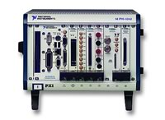
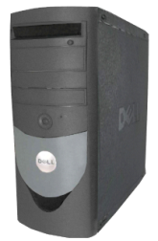
LabVIEW Real-Time Hardware Targets
LabVIEW Real-Time
Compact FieldPoint
PXI
Compact Vision System
CompactRIO
Desktop or Industrial PC
Notes:
There are, however, a variety of real-time targets available to you, including CompactRIO, Compact FieldPoint, or even a converted desktop PC. The concepts we discuss in this seminar can be applied to each of these systems.

Slide 85
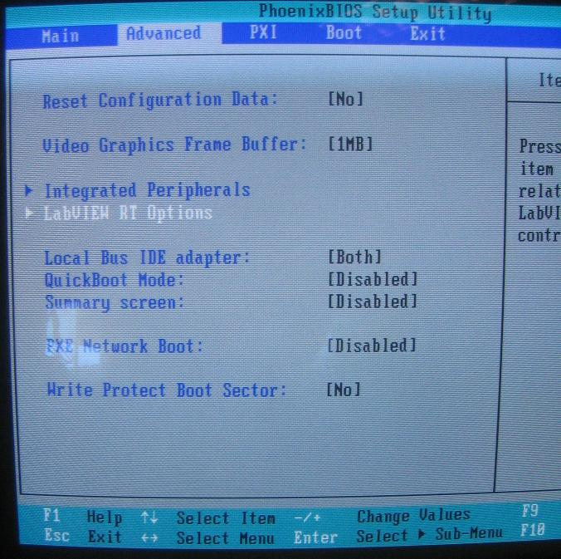
Dual Boot PXI Controllers
PXI 818X and newer controllers
RT safe mode loaded in EEPROM
BIOS boot option

Slide 86
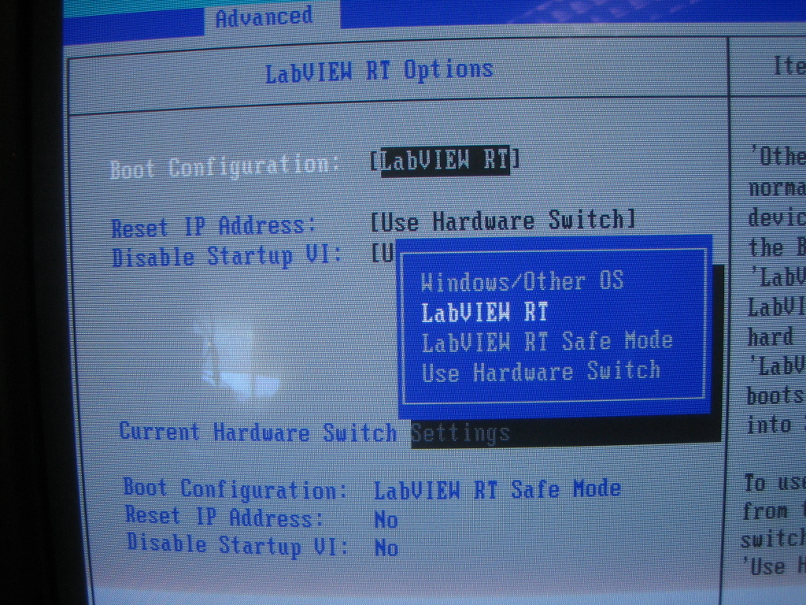
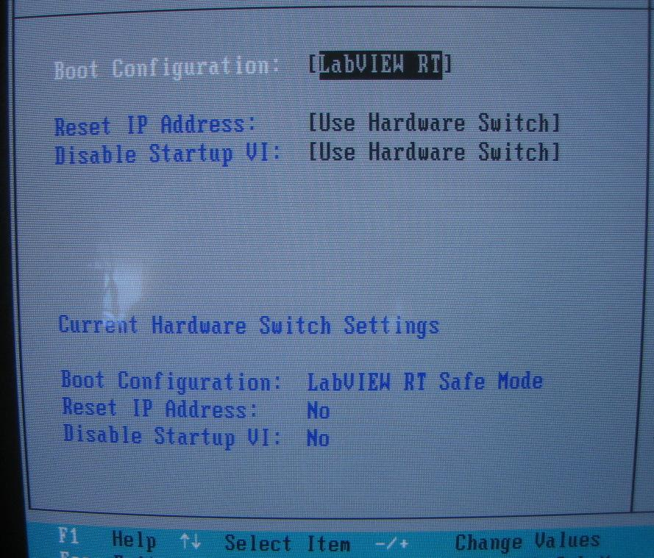
Dual Boot PXI Controllers (Cont.)

Slide 87
PXI controllers running RT OS
Information to help troubleshoot PXI/RT Issues…
RT target connects to host PC via Ethernet
Host and RT target must be on the same subnet
Host and RT target must have same software (driver versions should be the same)
Under Remote Systems, right-click the Software listing and select “Install Software”
Notes:
If you’re not sure if it’s RT or PXI hardware, bring on a RT supporter and tag-team it!

Slide 88
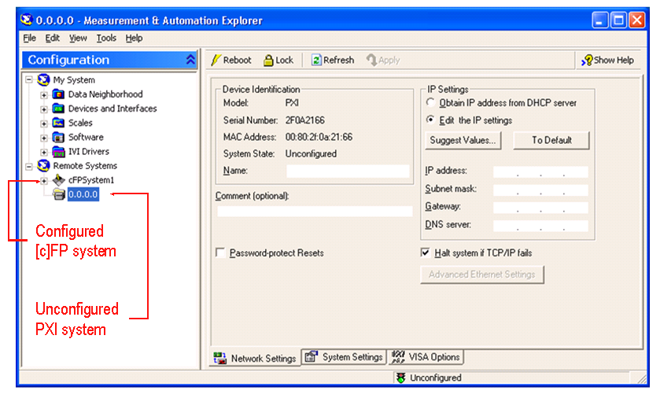
PXI controllers running RT OS (cont.)
PXI system shows up under Remote Systems in MAX to be configured

